Slide 1
Reproducible, One-Button Workflows with the Jupyter Notebook and SCons
Jessica Hamrick
UC Berkeley & Project Jupyter
@jhamrick
Notes:
What is the best way to develop analysis code in the Jupyter notebook, while managing complex dependencies between analyses? In this talk, I will introduce nbflow, which is a project that integrates a Python-based build system (SCons) with the Jupyter notebook, enabling researchers to easily build sophisticated, complex analysis pipelines entirely within notebooks while still maintaining a "one-button workflow" in which all analyses can be executed, in the correct order, from a single command. I will show how nbflow can be applied to existing analyses and how it can be used to construct an analysis pipeline stretching the entire way from data cleaning, to computing statistics, to generating figures, and even to automatically generating LaTeX commands that can be used in publications to format results without the risk of copy-and-paste error.

Slide 2
An idealized analysis pipeline…

Slide 3
Human Data
Simulation Data
Clean Data
Clean Data
Fit Model Parameters
Compute Averages w/ Conf. Intervals
Compute Correlations
Generate LaTeX results
Plot Averages
Plot Correlations
Copy results to paper
Compile LaTeX paper

Slide 4
How do we achieve this idealized workflow?

Slide 5
Approach 1: one big script
Drawback: no interactivity ☹

Slide 6
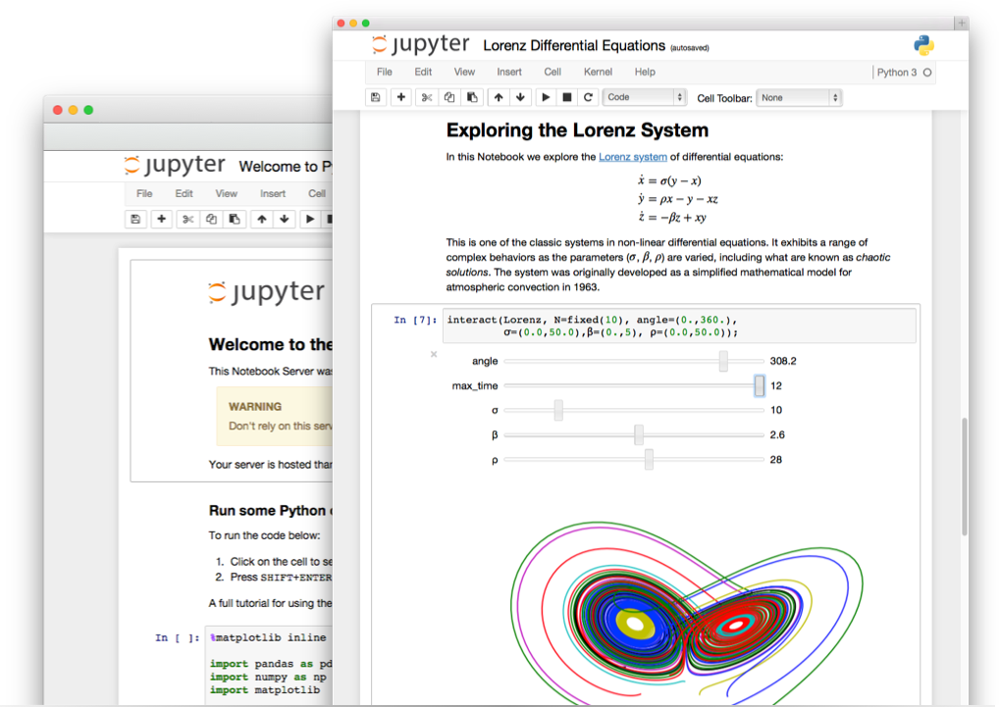
Notebooks are interactive!

Slide 7
Approach 2: one big notebook
Drawback: can be unwieldy ☹

Slide 8
Approach 3: multiple scripts
and / or notebooks
Drawback: dependency hell ☹

Slide 9
Approach 4: multiple scripts and / or notebooks with a
traditional build system

Slide 10
Traditional Build Systems
Make
CMake
SCons
…
Idea: Run a series of commands in order, ensuring dependencies are satisfied

Slide 11
Human Data
Simulation Data
Clean Data
Clean Data
Fit Model Parameters
Compute Averages w/ Conf. Intervals
Compute Correlations
Generate LaTeX results
Plot Averages
Plot Correlations
Compile LaTeX paper

Slide 12
An example SConstruct file
$ scons
scons: Reading SConscript files ...
scons: done reading SConscript files.
scons: Building targets ...
... a whole bunch of output ...
scons: done building targets.

Slide 13
But what if we want to run notebooks?

Slide 14
Notebooks can be commands!
$ jupyter nbconvert \
--execute \
--to notebook \
--output notebook.ipynb \
notebook.ipynb

Slide 15
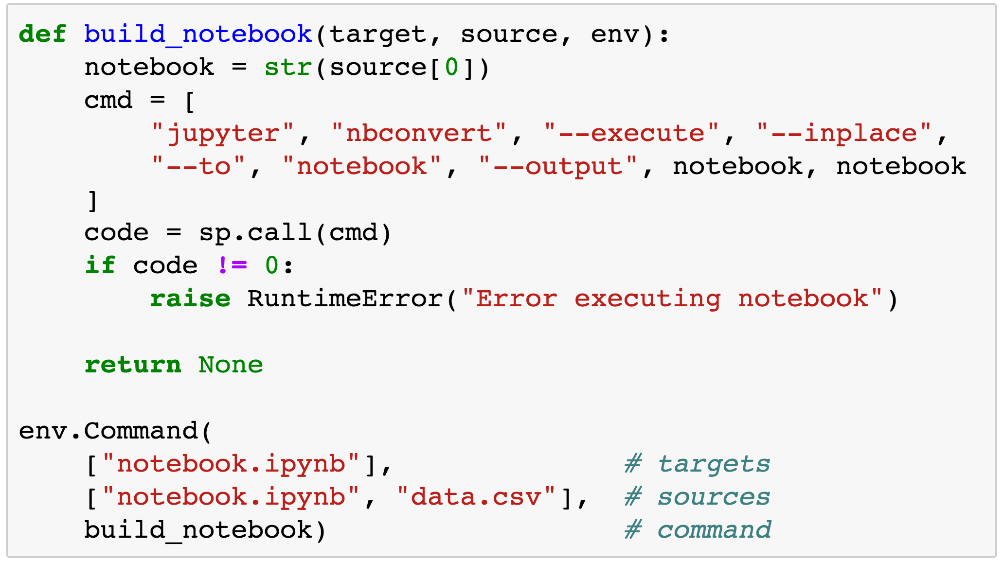
Notebooks can be SCons commands!

Slide 16
Approach 4: multiple scripts
and / or notebooks with SCons
Drawback: keeping the
SConstruct file up-to-date
is a hassle ☹

Slide 17
Approach 4: multiple scripts
and / or notebooks with nbflow
Drawback: notebooks must be
Python, requires Python 2 ☹ (but notebooks can be Python 3)

Slide 18
Installing nbflow
$ pip2 install \
git+git://github.com/jhamrick/nbflow.git

Slide 19
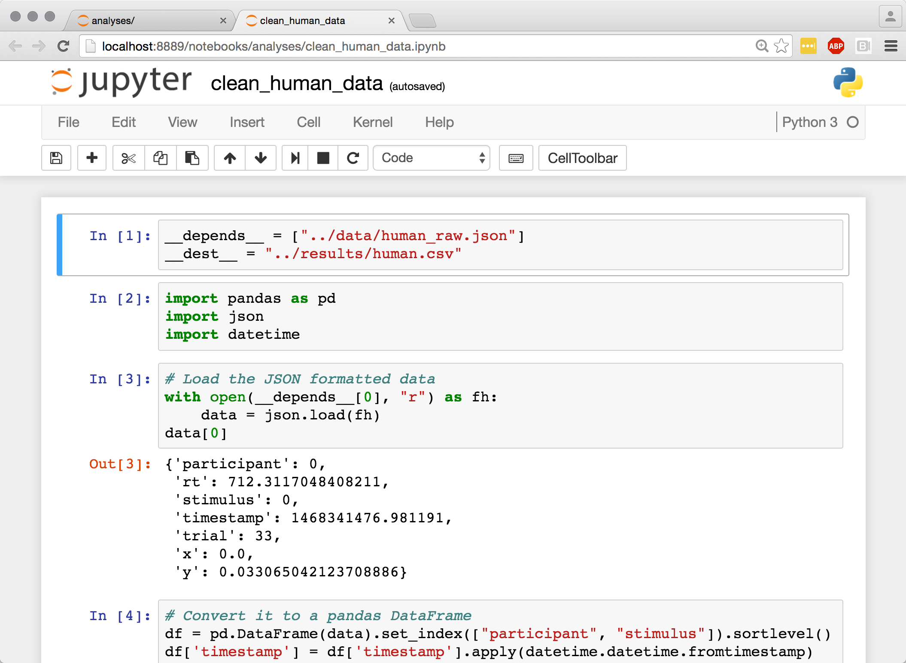
Notebooks with nbflow

Slide 20
SConstruct file with nbflow
$ scons
scons: Reading SConscript files ...
scons: done reading SConscript files.
scons: Building targets ...
... a whole bunch of output ...
scons: done building targets.

Slide 21
Demo!
data/human_raw.json
data/model_raw.npz
analyses/clean_human_data.ipynb
analyses/clean_simulation_data.ipynb
results/human.csv
results/model.csv
analyses/human_averages.ipynb
results/model_v_human.tex
analyses/fit_model_parameters.ipynb
results/human_averages.csv
Compile LaTeX paper
figures/model_v_human.pdf
figures/human_averages.pdf

Slide 22
Demo!
data/human_raw.json
data/model_raw.npz
analyses/clean_human_data.ipynb
analyses/clean_simulation_data.ipynb
results/human.csv
results/model.csv
analyses/human_averages.ipynb
results/model_v_human.tex
analyses/fit_model_parameters.ipynb
results/human_averages.csv
Compile LaTeX paper
figures/model_v_human.pdf
figures/human_averages.pdf

Slide 23
Future Improvements
Supporting non-Python kernels
Supporting other build systems
Python 3
http://tinyurl.com/nbflow-example

